Slide 1


Martyn’s Law Communications Toolkit
June 2026

Slide 2
Contents
Overview
Martyn’s Law resources
Example social posts
Example newsletter/web copy
Martyn’s Law explained
  Overview video & leaflet
  Who’s in scope infographics
  Role of the regulator infographic
  Animations
Slides to add to presentations
Useful links – signposting for further reading
How else to get involved

Slide 3


Overview
The Terrorism (Protection of Premises) Act 2025, known as Martyn’s Law, is expected to come into force in Spring 2027 to reduce the risk of harm at public premises and events in the case of a terrorist attack.
Named after Martyn Hett, one of the 22 people killed in the Manchester Arena attack, Martyn’s Law aims to make people safer by ensuring premises and events have appropriate plans in place to respond to acts of terrorism.
The focus for those in scope is on what is appropriate and reasonably practicable for the individual premises or event.
As the regulator of Martyn’s Law, the Security Industry Authority is here to support those responsible for qualifying premises and events to comply and help them understand what they need to do to prepare.

Slide 4

Overview
We want to make sure those responsible are aware that Martyn’s Law is coming, know if it applies to them and understand the steps they need to take to comply ready for when it comes into force next year.
This communications toolkit is designed to help you share materials about Martyn’s Law with your networks. You will find suggested copy and creative assets to share via your channels. Your support is vital as premises and events prepare for Martyn’s Law. The toolkit will be updated as new guidance materials are developed.
If you have any questions about the content in this toolkit or suggestions for future content, please contact the team: events@sia.gov.uk

Slide 5


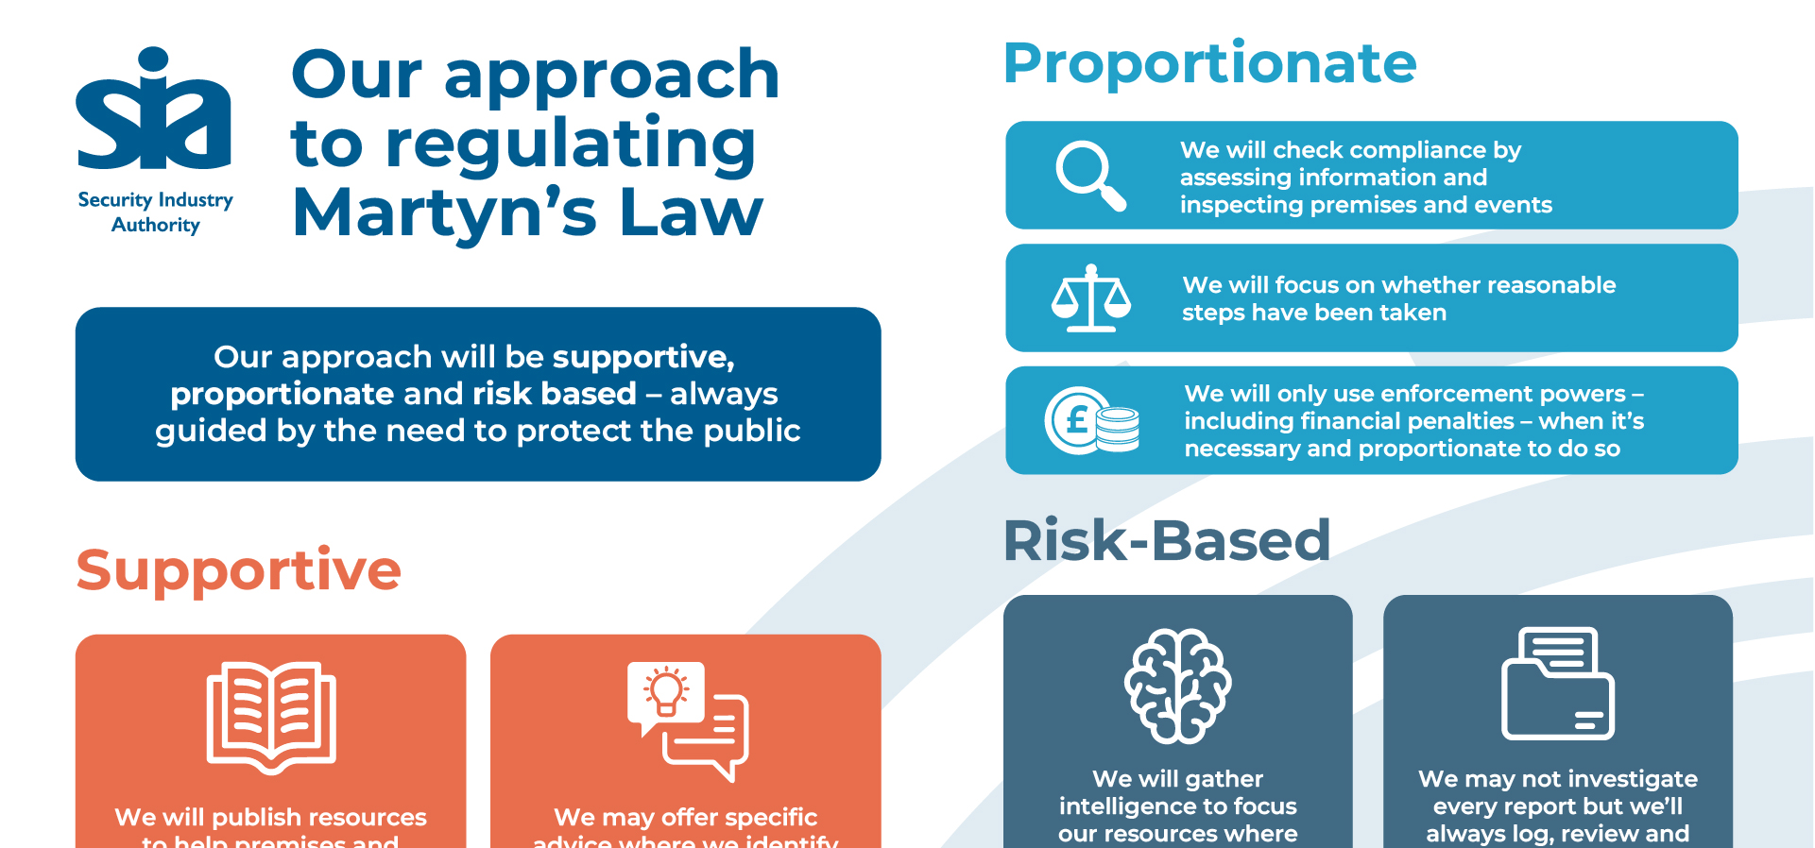
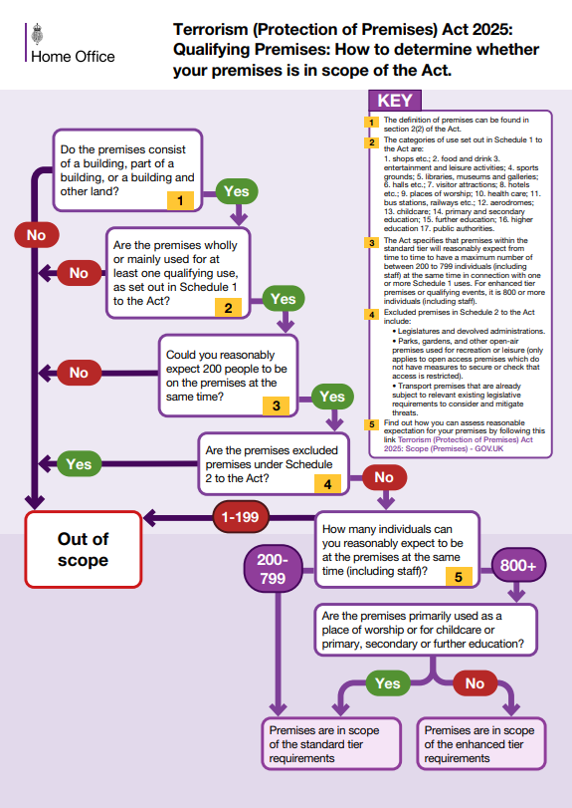
Martyn’s Law resources
All of our Martyn’s Law resources can be downloaded through the links in this toolkit or on our online media hub:
Photography
Presentation slides
Infographics

Slide 6
Social posts - overview
These social posts can be tailored for use across your channels:
Facebook / Instagram
LinkedIn
Martyn’s Law Regulation is expected in Spring 2027 and will help keep people safe at premises and events.
Now is the time to identify if you will be in scope and your requirements.
The @UKHomeOffice has produced guidance which will help you identify if your specific premises or event is in scope.
Sign up for updates from the SIA.
Martyn’s Law Regulation is expected in 2027 and will help keep people safe at premises and events.
Now is the time to identify if you will be in scope and your requirements.
The @UKHome Office has produced guidance which will help you identify if your specific premises or event is in scope.
Further useful materials can be found on Protect UK, which provides free advice, guidance and learning to help businesses and communities improve their response to the risk of terrorism.
Sign up for updates from the SIA #martynslaw
X
The @UKHomeOffice has produced guidance which will help you identify if your specific premises or event is in scope of Martyn’s Law before it comes into force, which is expected in Spring 2027.#martynslaw
Image suggestion for social post

Slide 7
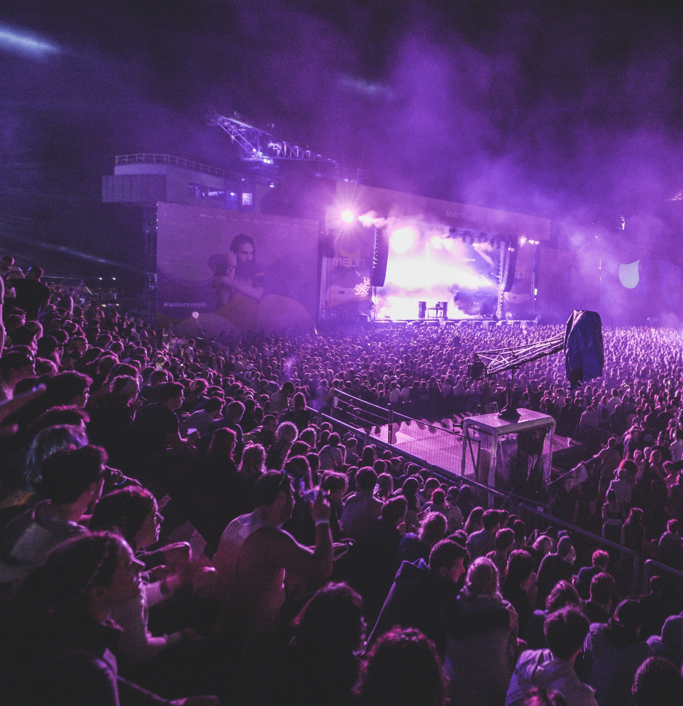
Social posts – the aim of Martyn's Law
LinkedIn
Facebook / Instagram
The @Security Industry Authority is the regulator for Martyn’s Law, which is expected to come into force in Spring 2027. The aim of this law is to reduce the risk of harm at public premises and events in the event of a terrorist attack.
As the regulator, the SIA will support those responsible for premises and events in scope to comply. If you’d like to receive updates from the SIA, you can sign up now.
#martynslaw
Martyn’s Law aims to make people safer by ensuring premises and events have appropriate plans in place in case of an act of terrorism. It is named after Martyn Hett, one of the twenty-two people killed in the Manchester Arena attack.
As the regulator, @theSIAuk is there to support those responsible for qualifying premises and events to comply and help them understand what they need to do to prepare. If you’d like to receive updates from the SIA, you can sign up now.
X
As the regulator of Martyn’s Law, @theSIAuk is there to support those responsible for qualifying premises and events to comply.
Sign up to receive updates
#martynslaw
Image suggestion for social post

Slide 8
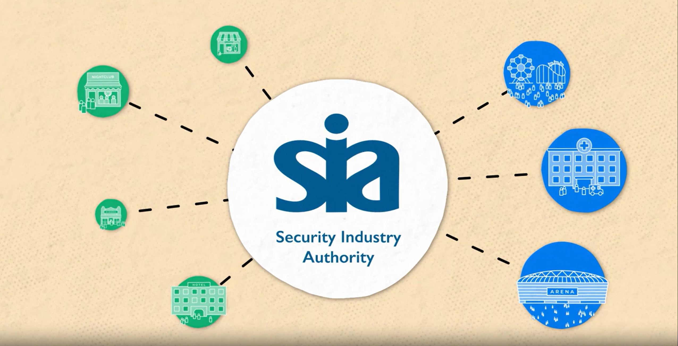
Social posts – scope of Martyn's Law
Facebook / Instagram
LinkedIn
Martyn’s Law Regulation is coming in 2027 and will help keep people safe at premises and events.
If your premises or event is in scope, it’s worth starting to think about what you will need to do:
protectuk.police.uk/sites/default/files/2026-04/32.34_ho_mlaw_animation_03_v5_subbed.mp4
The @theSIAuk notification portal will become available when Martyn’s Law comes into force. This is currently expected to be in Spring 2027. Sign up for updates from the SIA
Martyn’s Law Regulation is coming in 2027 and will help keep people safe at premises and events.
If your premises or event is in scope, it’s worth starting to think about the legal requirements and what some of the right protective security measures might look like: protectuk.police.uk/sites/default/files/2026-04/32.34_ho_mlaw_animation_03_v5_subbed.mp4
The @Security Industry Authority notification portal will become available when Martyn’s Law comes into force. This is currently expected to be Spring 2027. Sign up for updates from the SIA #martynslaw
Featured video to use:
What are your legal requirements under the act’
Download
X
If your premises or event is in scope of Martyn’s Law, it’s time to start thinking about the legal requirements: protectuk.police.uk/sites/default/files/2026-04/32.34_ho_mlaw_animation_03_v5_subbed.mp4
#martynslaw
Notes:
Watch: new Martyn’s Law explainer video | ProtectUK

Slide 9
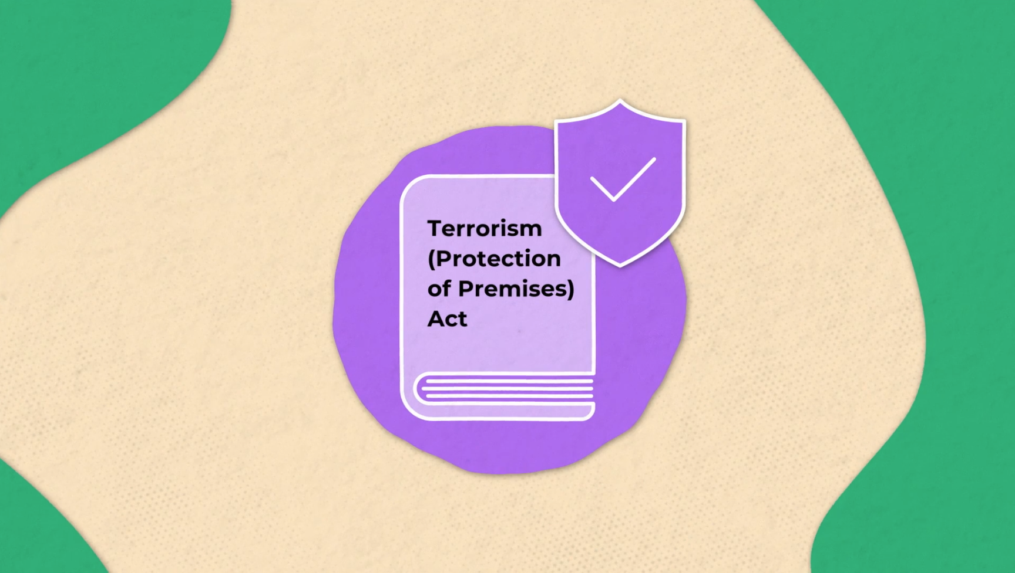
Social posts – video explainer
Facebook / Instagram
LinkedIn
Named after Martyn Hett, one of the 22 people killed in the Manchester Arena attack, Martyn’s Law aims to make people safer by ensuring premises and events have appropriate plans in place to respond to acts of terrorism.
The @UKHomeOffice has produced a video explainer of Martyn’s Law. Find out what it might mean for you: Watch: new Martyn’s Law explainer video | ProtectUK
As the regulator, @theSIAuk is there to support those responsible for qualifying premises and events to comply. If you’d like to receive updates from @theSIAuk, you can sign up now.
The @UK Home Office has produced a video explainer of Martyn’s Law. Find out what it might mean for you:
Watch: new Martyn’s Law explainer video | ProtectUK
As the regulator, the @Security Industry Authority is there to support those responsible for qualifying premises and events to comply. If you’d like to receive updates from @The Security Industry Authority, you can sign up now. #martynslaw
Featured video to use:
‘Terrorism (Protection of Premises Act) – Martyn’s Law’
Download
X
The @UKHomeOffice has produced a video explainer of Martyn’s Law. Find out what it might mean for you:
Watch: new Martyn’s Law explainer video | ProtectUK. If you’d like to receive updates from @theSIAuk, you can sign up now. #martynslaw

Slide 10
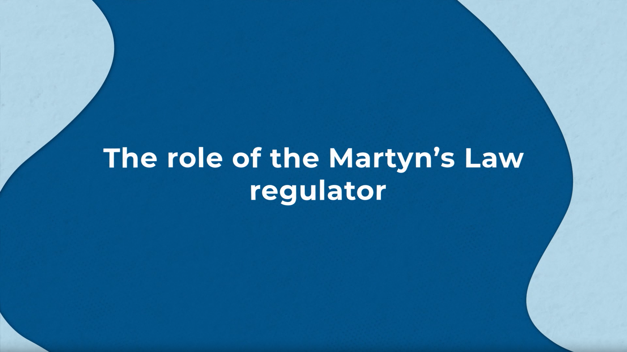
Social posts – role of the SIA (continued)
Facebook / Instagram
LinkedIn
Martyn’s Law Regulation is coming in 2027 and will help keep people safe at premises and events.
The regulator of Martyn’s Law, @theSIAuk will be supportive, proportionate and risk-based in its approach to regulating Martyn's Law.
You can find out more: protectuk.police.uk/sites/default/files/2026-07/32.34_HO_MLAW_Animation 04_V4_SUBBED.mp4
If you’d like to receive updates from the SIA, you can sign up now.
Martyn’s Law Regulation is coming in 2027 and will help keep people safe at premises and events.
The regulator of Martyn’s Law, the @Security Industry Authority will be supportive, proportionate and risk-based in its approach to regulating Martyn's Law.
You can watch this video to find out more: protectuk.police.uk/sites/default/files/2026-07/32.34_HO_MLAW_Animation 04_V4_SUBBED.mp4
If you’d like to receive updates from the SIA, you can sign up now. #martynslaw
Featured video to use:
‘The role of the Martyn’s Law regulator’
Download
X
The regulator of Martyn’s Law, @theSIAuk will be supportive, proportionate and risk-based.
If you’d like to receive updates from the SIA, you can sign up now. #martynslaw
Notes:
Watch: new Martyn’s Law explainer video | ProtectUK

Slide 11
Website/newsletter copy
Preparing for Martyn’s Law
The Terrorism (Protection of Premises) Act, known as Martyn’s Law, is expected to come into force in Spring 2027 to reduce the risk of harm at public premises and events in case of a terrorist attack.
Named after Martyn Hett, one of the 22 people killed in the Manchester Arena attack, Martyn’s Law aims to make people safer by ensuring premises and events have appropriate plans in place to respond to acts of terrorism.
Now is the time to identify if you will be in scope and what you need to do to comply.
The Home Office has produced guidance outlining the steps necessary for premises and events to comply which must be on everyone’s ‘to read’ list. The focus if you are in scope is on what is appropriate and reasonably practicable for your premises or event.
As the regulator, the Security Industry Authority will support those responsible for premises and events in scope to comply.
If you’d like to receive updates from the SIA, you can sign up now.

Slide 12
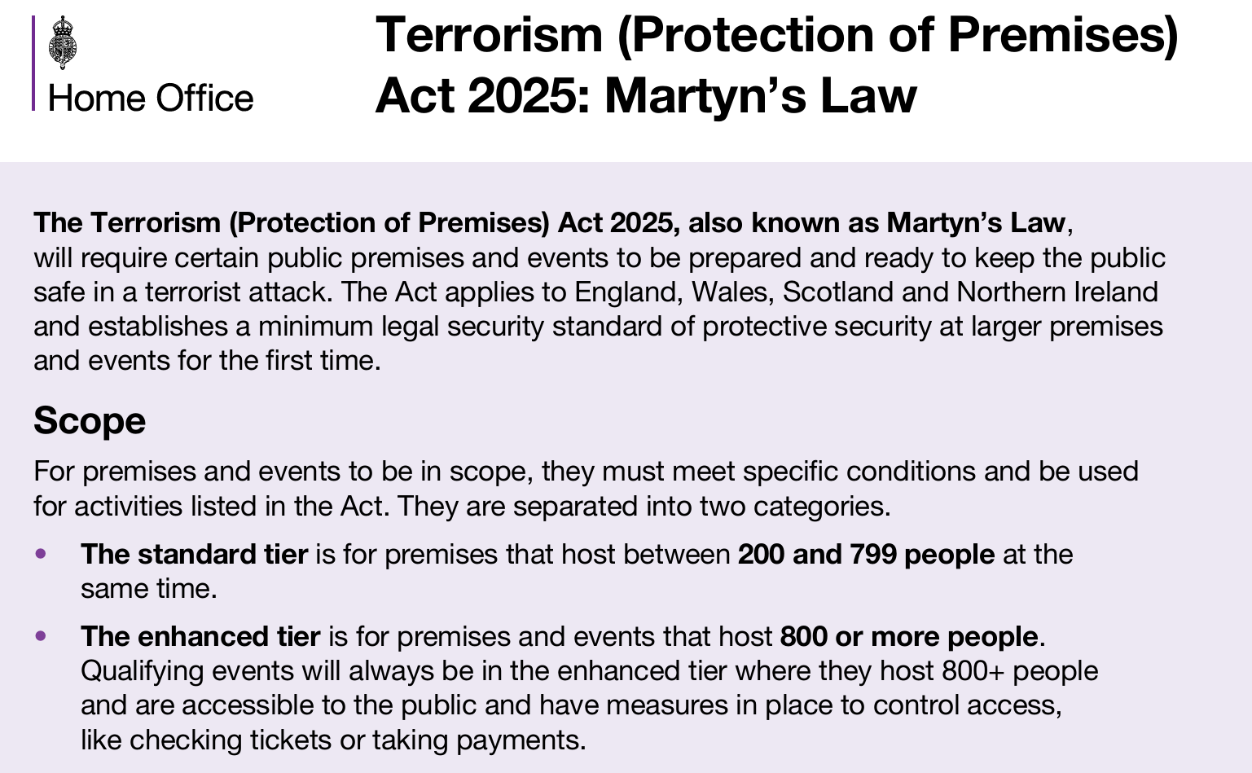
Martyn’s Law explained: Overview video & leaflet
This leaflet and video provide a useful overview so are a good starting point for anyone wanting to find out more.
The video can be embedded in your website and wider materials or shown at events:
Watch Martyn’s Law explainer video
Read Martyn's Law Leaflet

Slide 13
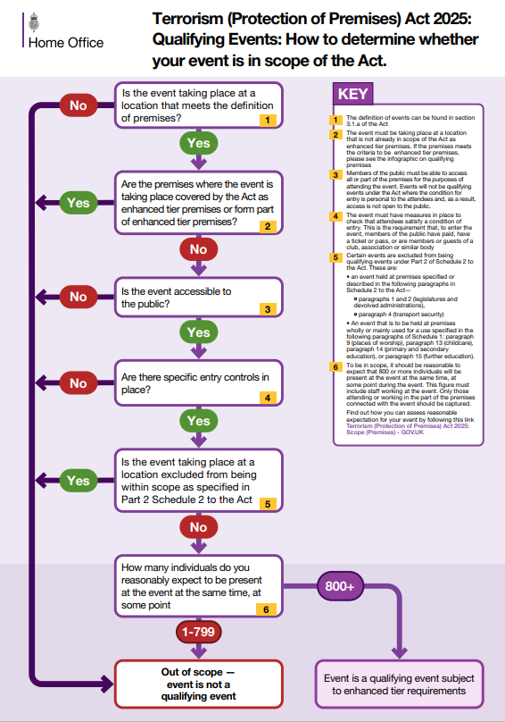
Martyn's Law explained: Scope infographics
We recommend you download and share these infographics to help premises and events assess if they’re in scope.
We suggest you encourage people to first review the premises infographic then the events infographic.
Download
Premises Infographic
Download
Events Infographic
Download
Premises Infographic
Notes:
Existing ProtectUK infographic to assess if you’re in scope: Infographic Scope-Premises NM HD WEB (002).pdf and CS NM Infographic Scope- Events [WEB].pdf

Slide 14
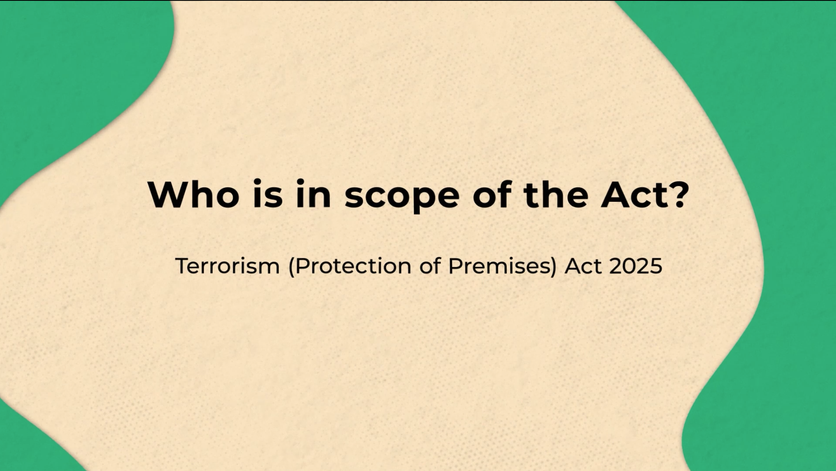
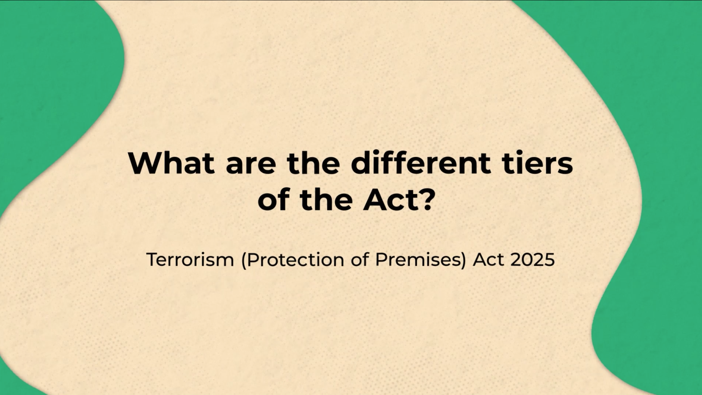
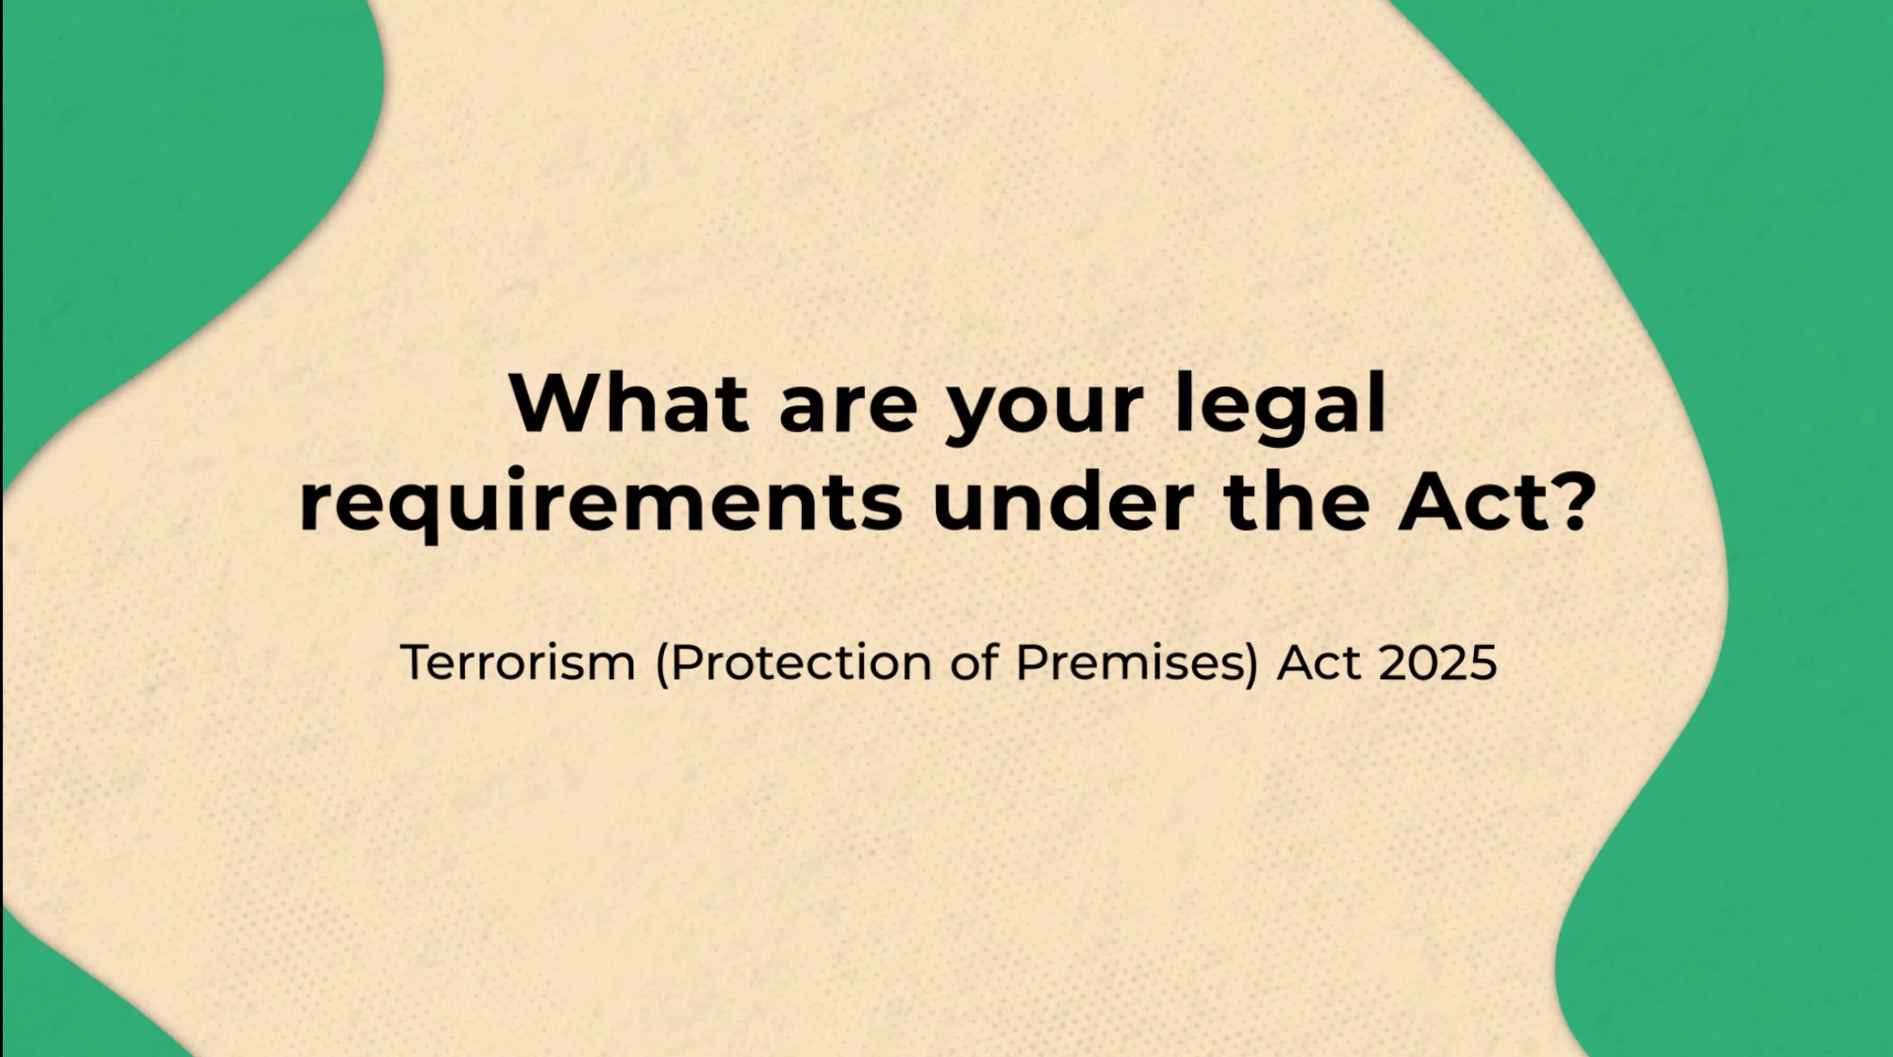
Martyn's Law explained: Animations
These animations can be used to help explain different aspects of Martyn’s Law on your website or social channels or at events:
Who is in scope
of the Act?
What are the different tiers of the Act?
What are the legal requirements under
the Act?
Notes:
Existing HO animations x 3: protectuk.police.uk/sites/default/files/2026-04/32.34_ho_mlaw_animation_01_v6_subbed_0.mp4 and protectuk.police.uk/sites/default/files/2026-04/32.34_ho_mlaw_animation_02_v5_subbed.mp4 and protectuk.police.uk/sites/default/files/2026-04/32.34_ho_mlaw_animation_03_v5_subbed.mp4

Slide 15
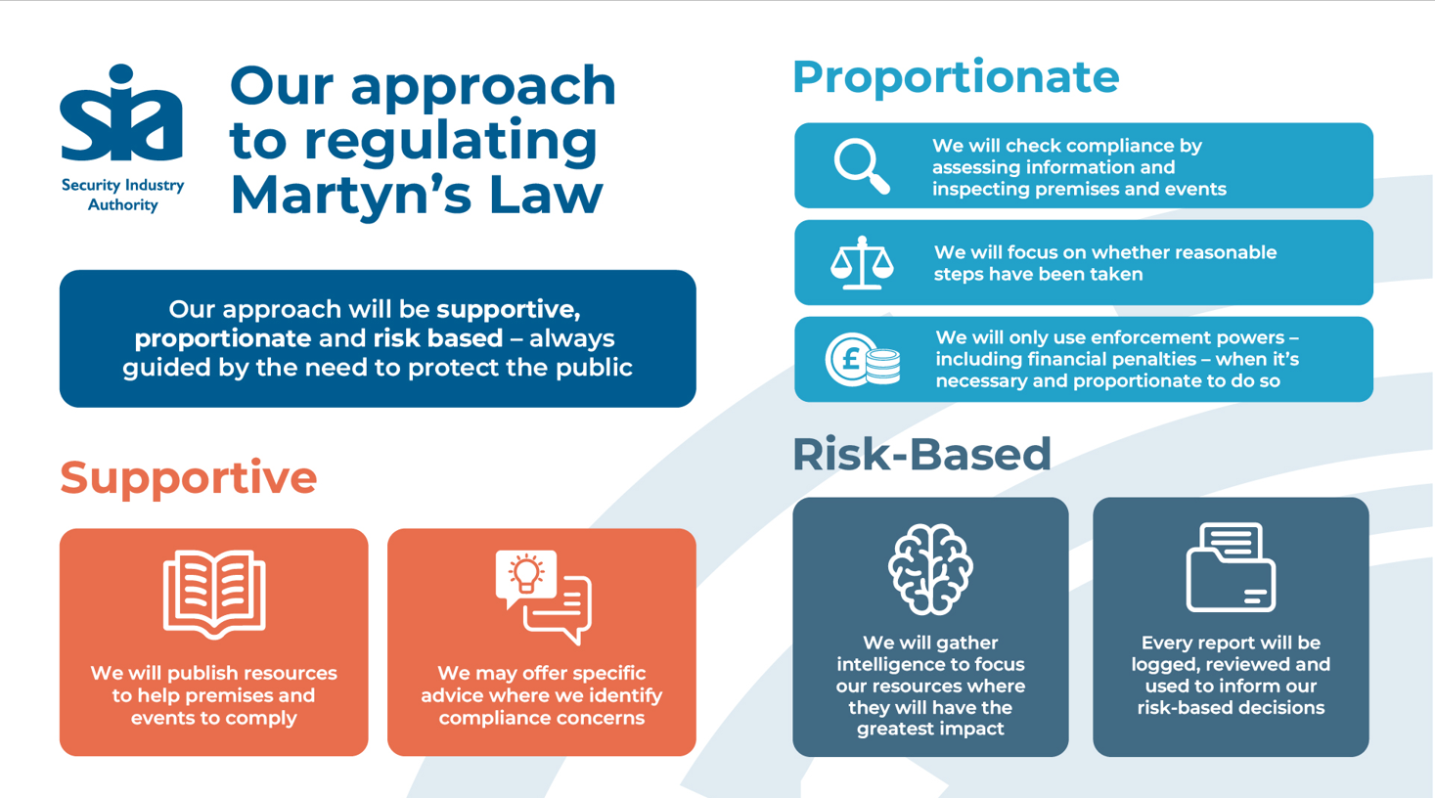
Slides for presentations
Do let us know if you’d be interested in us attending your events.
We’ve also developed slides on Martyn’s Law that you can drop in to your presentations.
SIA: Role of the regulator
Download

Slide 16
Useful links for further reading
These links can also be helpful to signpost to:
Martyn's Law: the SIA's new regulatory role - GOV.UK
Updates on Martyn's Law from the SIA's Laura Gibb: https://www.gov.uk/government/collections/martyns-law-and-the-sias-role-as-regulator#updates-from-our-executive-directors
Terrorism (Protection of Premises) Act 2025 – Section 27 Statutory Guidance: Terrorism (Protection of Premises) Act 2025 Statutory Guidance
SIA Section 12 guidance – to note, this is a draft only and a final version will be published in the Autumn: sia-martyns-law-s12-consultation.odt
ProtectUK: Martyn’s Law Resources Page (including infographics and animated videos)
Terrorism (Protection of Premises) Act 2025: Full text of the Act on legislation.gov.uk

Slide 17

How else to get involved
We’d love to work together to raise awareness of Martyn’s Law.
With that in mind, do get in touch if we can:
Answer any questions
Attend / speak at any upcoming events
(depending on availability)
Produce more tailored content for your communications channels e.g. blogs, interviews, videos
Speak to your networks about how prepared they feel and any concerns they have via forums or surveys
Please contact the team: events@sia.gov.uk

